Slide 1
Evaluation in Document Retrieval 文档检索系统评价
References:
James Allan, University of Massachusetts Amherst
Pandu Nayak and Prabhakar Raghavan, Stanford University
Notes:
The key points:
Pooling method
2. Precision and Recall for ranked list
3. MAP: mean average precision
4. F-Measure
5. TREC

Slide 2
Evaluation in document retrieval: outline
Relevance (相关性) and test collections
Effectiveness measures (有效性度量)
Recall and precision (召回率与精度)
E and F
Expected search length (期望搜索长度)
TREC Conference
Other issues and problems

Slide 3
Relevance
Sec. 8.1
How do you measure relevance?
Relevance measurement requires 3 elements:
A benchmark document collection
A benchmark suite of queries
A usually binary assessment of either Relevant or Nonrelevant for each query and each document
Some work on more-than-binary, but not the standard
What’s the main challenges of relevance measurement?
3
Notes:
Let students discuss the measure of relevance

Slide 4
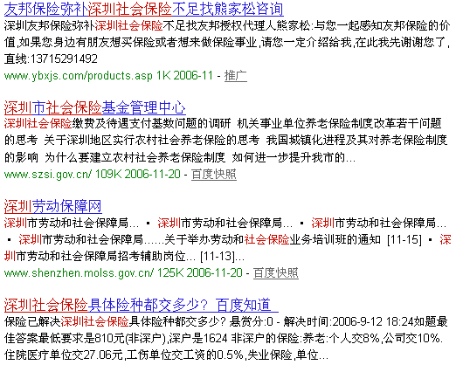

Relevance
Relevance is difficult to define satisfactorily
Note: the information need is translated into a query
Relevance is assessed relative to the information need not the query
A relevant document is one judged useful in the context of a query
Who judges? What is useful?
Humans not very consistent
Judgments depend on more than document and query
Input “深圳社会保险”, get 2 result sets
Which one is more relevant to the user’s information need?
Notes:
For example, assume that a user is preparing for an plan of 2-days tour in Paris and this is s/he’s first time to Paris, ask different users to write down 3 keywords for searching information they are trying to get for this plan. Then what we will get?

Slide 5
Test Collections
With real collections, never know full set of relevant documents
A test collection usually consists of
set of documents
set of queries
set of relevance judgments (which docs relevant to each query)
To compare the performance of two techniques:
each technique used to evaluate test queries
results (set or ranked list) compared using some performance measure
most common measures - precision and recall
Usually use multiple measures to get different views of performance
Usually test with multiple collections - performance is collection dependent

Slide 6
Chinese Web Corpus
Data from Sogou
SogouT (collected in 2008)
http://www.sogou.com/labs/dl/t.html
0.13 billion Webpages (5TB).
SogouQ
About 1 month of user query logs with user clicked URLs

Slide 7
The Way of Finding Relevant Documents
Question: did system find all relevant material?
To answer accurately, collection needs complete judgments
i.e., “yes,” “no,” or some score for every query-document pair
For small test collections, can review all documents for all queries
Not practical for large or medium-sized collections
TREC collections have millions of documents
Other approaches that can be used
Pooling
Sampling
Search-based
Notes:
Here, before the part 2 shown, ask students for discussion.

Slide 8
Finding relevant documents (2)
Search-based
Rather than read every document, use manually-guided search
Read retrieved documents until convinced all relevance found
Sampling
Possible to estimate size of true relevant set by sampling
Pooling
Retrieve documents using several (usually automatic) techniques
Judge top n documents for each technique
Relevant set is union
Subset of true relevant set
All are incomplete, so when testing:
How should unjudged documents be treated?
How might this affect results?

Slide 9
Evaluation in document retrieval: outline
Relevance and test collections
Effectiveness measures(有效性度量)
Recall and precision (召回率和精度)
E and F
Expected search length （期望搜索长度）
Significance tests
Other issues and problems

Slide 10
Precision and Recall
Precision(精度)
Proportion of a retrieved set that is relevant
Precision = |relevant ∩ retrieved| ÷ |retrieved| = P( relevant | retrieved )
Recall(召回率)
proportion of all relevant documents in the collection included in the retrieved set
Recall = |relevant ∩ retrieved| ÷ |relevant| = P( retrieved | relevant )
Notes:
P and R should be explained from Set theory and probability theory views

Slide 11

Another common representation
Relevant = A+C
Retrieved = A+B
Collection size = A+B+C+D
Precision = A ÷ (A+B)
Recall = A ÷ (A+C)
Miss = C ÷ (A+C) （漏识)
False alarm (fallout) = B ÷ (B+D)（误报）

Slide 12
Precision and Recall
Precision and recall are well-defined for sets (for unranked collection)
For ranked retrieval, how to compute P/R values?
Compute a P/R point for each relevant document
Compute value at fixed recall points (e.g., precision at 20% recall)
Compute value at fixed rank cutoffs (e.g., precision at rank 20)
Notes:
P and R should be explained from Set theory and probability theory views

Slide 13

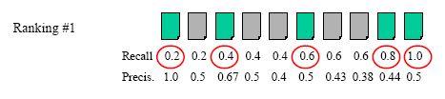
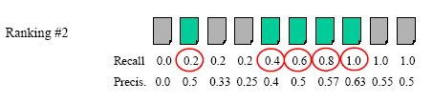
Precision and Recall for Ranked List
Computing the precision and recall based on ranking

Slide 14
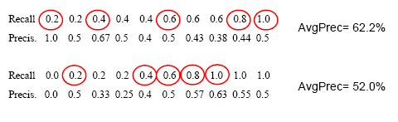
Average precision of a query
Often want a single-number effectiveness measure
E.g., for a machine-learning algorithm to detect improvement
Average precision is widely used in IR
Calculate by averaging precision when recall increases

Slide 15

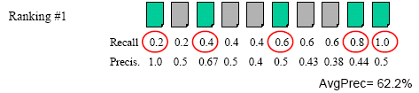
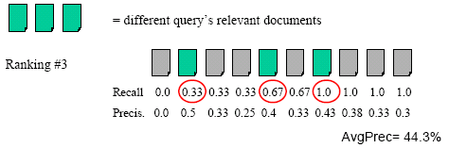
Precision and Recall example 2
Back to Averaging graphs
Notes:
Because that their denominator is different.

Slide 16
Averaging across queries
It’s very hard to compare P/R graphs or tables for individual queries (too much data)
Need to average over many queries
Two main types of averaging
Micro-average - each relevant document is a point in the average
Macro-average - each query is a point in the average (Most Common)
What does each tell someone evaluating a system?
Why use one over the other?
MAP
Average of many queries’ average precision values
Called mean average precision (MAP)
“Average average precision” sounds weird
Notes:
The Lecture is ended at here

Slide 17
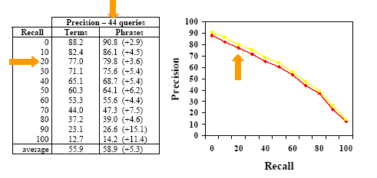
Recall/precision graphs
Average precision hides information
Sometimes better to show tradeoff in table or graph

Slide 18
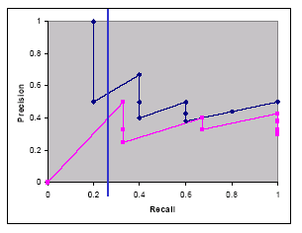
Averaging graphs: a false start
How can graphs be averaged?
Different queries have different meaningful recall values
Recall/precision graph also has odd saw-shape (锯齿状) if done directly
Sample graphs (In example 2)
What is precision at 25% recall?
Need to interpolate
But how?
Notes:
The 3rd lecture started from here

Slide 19
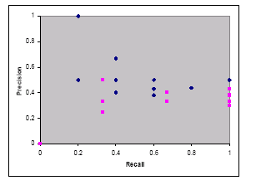
Possible interpolation approaches
No interpolation
Not very useful
Connect the dots
Connect max
Connect min
Connect average
…
How to deal with 0% recall?
Assume 0?
Assume best?
Constant start?

Slide 20
How to choose?
It is an empirical fact that on average as recall increases, precision decreases
Verified time and time again
On average
Seems reasonable to aim for an interpolation that makes function monotonically decreasing (单调递减)
One approach:
where S is the set of observed (R,P) points
Results in a step function

Slide 21
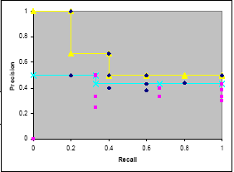
Our example, interpolated this way
Monotonically drops
Average will also fall monotonically
Note R=0.67 and R=0.8
Handles 0% recall smoothly

Slide 22

Our example (Cont’d)
Select the maximum value
Given the data by Ranking #1
What’s the precision at 0.25 recall?

Slide 23
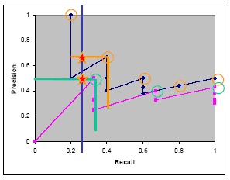
Averaging graphs: using interpolation
How can graphs be averaged?
Different queries have different meaningful recall values
Recall/precision graph also has odd saw-shape if done directly
Sample graphs (example 2)
What is precision at 25% recall?
Interpolate values
average

Slide 24
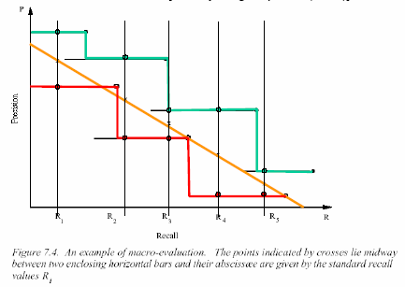
Interpolation and averaging
[van Rijsbergen, p. 118 (1979)]

Slide 25
Interpolated average precision
Average precision at standard recall points
For a given query, compute P/R point for every relevant doc.
Interpolate precision at standard recall levels
11-pt is usually 100%, 90, 80, …, 10, 0% (yes, 0% recall)
3-pt is usually 75%, 50%, 25%
Average over all queries to get average precision at each recall level
Average interpolated recall levels to get single result
Called “interpolated average precision”
Not used much anymore; “mean average precision” (MAP) more common
Values at specific interpolated points still commonly used

Slide 26
Evaluation in document retrieval: outline
Relevance and test collections
Effectiveness measures
Recall and precision
E and F
Expected search length
TREC Conference
Other issues and problems

Slide 27


More Single-Valued Measures
E measure (van Rijsbergen)*
Used to emphasize precision (or recall)
essentially a weighted average of precision and recall
large α increases importance of precision
Can transform by α = 1/(β² +1), β = P/R
When β = 1 (α = ½) equal importance of precision and recall
Normalized symmetric difference of retrieved and relevant sets
Notes:
*Since it is not so popular now, skip this part

Slide 28
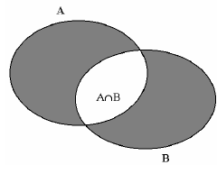
Symmetric Difference and E
A is the retrieved set of documents
B is the relevant set of documents P = |A∩B| ÷ |A| R = |A∩B| ÷ |B|
A ⊗ B (the symmetric difference) is the shaded area |A ⊗ B|= |A∪B| - |A∩B| = |A| + |B| - 2|A∩B|
E _{β}=1 - (2PR ÷ (P+R)) = (P+R-2PR) ÷ (P+R) = … = |A ⊗ B| ÷ (|A| + |B|)

Slide 29


F measure
F = 1- E often used
Good results mean larger values of F
“F1” measure is popular: F with β=1
Particularly popular with classification researchers

Slide 30

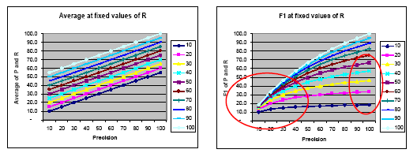
F measure as an average
Harmonic mean(调和平均) of P and R
Inverse of average of their inverses
Heavily penalizes low values of P or R
Compared to standard average

Slide 31
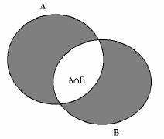
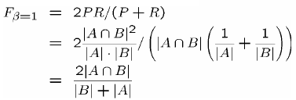
F measure, geometric interpretation
A is the retrieved set of documents
B is the relevant set of documents
P = |A∩B| ÷ |A|
R = |A∩B| ÷ |B|

Slide 32
Evaluation in document retrieval: outline
Relevance and test collections
Effectiveness measures
Recall and precision
E and F
Expected search length
TREC Conference
Other issues and problems

Slide 33
Other Single-Valued Measures
Expected search length*
Breakeven point (损益平衡点)
point at which precision = recall
Popular in classification tasks, though not clear what it means
MRR (Mean Reciprocal Rank)
Many others...
Notes:
*Can be skipped depends on the time.
Detail introduce MRR since it is useful in QA system evaluation

Slide 34
Expected Search Length
Evaluation is based on type of information need:
1. only one relevant document required
2. some arbitrary number n
3. all relevant documents
4. a given proportion of relevant documents…..
Two types of ordering
Simple ordering: never have two or more documents at the same level of the ordering
Otherwise, weak ordering
Search length in a simple ordering
the number of non-relevant documents a user must scan before the information need is satisfied
Search strategy output assumed to be weak ordering
Expected search length appropriate for weak ordering

Slide 35
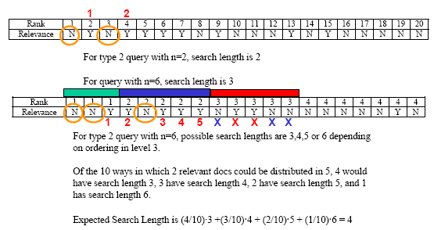
Expected Search Length
For simple ordering
?
For weak ordering
?
?

Slide 36
Expected Search Length
ESL(q) = Pnonrel + Fnonrel·Fneeded / (Frel+1)
q is the query
Pnonrel is the number of documents non-relevant to q in all levels preceding the final
Frel is number of relevant documents in final level
Fnonrel is number of non-relevant documents in final level
Fneeded is the number of relevant documents required from the final level to satisfy the need
Use mean expected search length for a set of queries
The measure is criticized for ignoring recall

Slide 37
Evaluation Problems
Retrieval techniques highly collection and query specific
Single technique must be tested on multiple collections
Comparison of techniques must be on same collection
Isolated tests not very useful
Standard methods assume user knows right collection
Usually impossible to control all variables with real systems
Hard to separate effects of retrieval model and interface when model requires user interaction
Good test collections are very hard (expensive) to produce
Usually can’t do cost-benefit analysis

Slide 38
Evaluation in document retrieval: outline
Relevance and test collections
Effectiveness measures
Recall and precision
E and F
Expected search length
TREC Conference
Other issues and problems

Slide 39
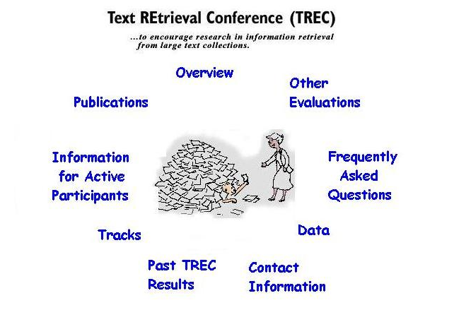
TREC Conference

Slide 40
TREC Conference (Cont’d)
Established in 1992 to evaluate large-scale IR
Retrieving documents from a gigabyte to terabytes collection
Has run continuously since then
TREC 2010 conference: Nov 16-19, at NIST (National Institute of Standards and Technology) in Gaithersburg, Md. USA
Run by NIST’s Information Access Division
Initially sponsored by DARPA as part of Tipster program
Now supported by many, including DARPA, ARDA, and NIST
Probably most well known IR evaluation setting
Started with 25 participating organizations in 1992 evaluation
In 2007, there were about 87 groups all over the world.
Proceedings available on-line (http://trec.nist.gov)
Overview and call for participation information of TREC 2010 at
http://trec.nist.gov/call2010.html

Slide 41
TREC general format
TREC consists of IR research tracks
–Ad-hoc retrieval (web track, up to one billion Web pages for 2010), routing, cross-language, scanned documents, speech recognition, query, video, filtering, Spanish, question answering, novelty, Chinese, high precision, interactive, Web, database merging, NLP, …
Each track works on roughly the same model
November: track approved by TREC community
Winter: track’s members finalize format for track
Spring: researchers train system based on specification
Summer: researchers carry out formal evaluation
Usually a “blind” evaluation: researchers do not know answer
Fall: NIST carries out evaluation
November: Group meeting (TREC) to find out:
How well your site did
How others tackled the problem
Many tracks are run by volunteers outside of NIST (e.g., Web)
“Coopetition(竞争中的合作)” model of evaluation
Successful approaches generally adopted in next cycle

Slide 42
TREC: pros and cons
Widely recognized, premier annual IR evaluation
What is good
Brings together a wide range of active researchers
Huge distributed resources applied to common task
Substantial gains on tasks rapidly
Valuable evaluation corpora (语料库) usually available after track completes
What is less good
Annual evaluation can divert resources from research
Evaluations often require significant engineering effort
Some tracks moving to bi-annually evaluation as a result
Recently, an explosion of tracks
Means less energy applied to individual tasks
TREC program committee keeps a tight rein on number of tracks
On balance?
Depends on your prejudices

Slide 43
Homework
Performance evaluation of Baidu, sogou(http://www.sogou.com ), Bing(http://www.bing.com )
Requirements:
In this homework, you are asked to evaluate these 3 commercial search engines (SEs) by Pooling method.
Queries: you are asked to compose at least 3 real queries
Relevant document collection: constructed by pooling method, i.e., you should run each query on these 3 search engines, then manually judge the relevant for top 20 documents returned by each SE. Then the union of all relevant documents come from these 3 rankings compose of the full relevant document set of the query.
Result analysis: draw one P/R graph for each query to compare these 3 SEs. Comparing the average performance of these systems by the MAP values.
Report:
Write a report to detail describe your evaluation procedure and your final conclusion in English, all the original queries, document collections with relevance judgments should be submitted.
Due Date:

Slide 44
Backup

Slide 45
Why significance tests?
System A beats System B on one query
Is it just a lucky query for System A?
Maybe System B does better on some other query
Need as many queries as possible
Empirical research suggests 25 is minimum needed
TREC tracks generally aim for at least 50 queries
System A and B identical on all but one query
If System A beats System B by enough on that one query, average will make A look better than B
As above, could just be a lucky break for System A
Need A to beat B frequently to believe it is really better
E.g. system A is only 0.00001% better than System B
Even if it’s true on every query, does it mean much?
Significance tests consider those issues

Slide 46
Sign Test Example
For techniques A and B, compare average precision for each pair of results generated by queries in test collection
If difference is large enough, count as + or -, otherwise ignore
Use number of +’s and the number of significant differences to determine significance level
For example, for 40 queries…
Technique A produced a better result than B 12 times
B was better than A 3 times
And 25 were “the same”…
p < 0.035 and technique A is significantly better than B at the 5% level
If A>B 18 times and B>A 9 times…
p < 0.122 and A is not significantly better than B at the 5% level (Chi-square test)
Where n₊ is the times that A performances better than B,
n₋ is the times that B performances better than A,
the value p should be queried from the test table.
(See attached file “x2检验.mht” for more info.)

Slide 47
Evaluation in document retrieval: outline
Types of evaluation
Relevance and test collections
Effectiveness measures
Recall and precision
E and F
Expected search length
Significance tests
Other issues and problems

Slide 48
Feedback Evaluation
Relevance feedback covered later
Two-pass approaches
Create better query out of results from original query
How to treat documents that have been seen before?
Rank freezing
Ranks of relevant documents fixed for subsequent iterations
Compare ranking with original ranking
Performance can’t get worse
Residual collection
All previously seen documents (e.g. top n) removed from collection
Compare reranking with original ranking (n+1…D)
Both approaches problematic
Users probably want to see good documents move to top of list

Slide 49
User Perceptions
Effectiveness measures give quality of retrieved list
Other measures important
Time to complete a retrieval task
User “satisfaction”
How well users believe system works
An “intelligent” IR system is one that does not look stupid to the users
User studies difficult to design and expensive to conduct
Hard to isolate effects of search engine and user interface
Hard to control for individual performance differences
TREC “interactive” track

Slide 50
Computational Aspects
Most models give theoretical bounds on costs for query evaluation and collection building
For large collections
Evaluation must be “nearly” independent of collection size
Building time should be no worse than linear
Staged retrieval
Use low cost model to get a set of potentially relevant documents
Apply more sophisticated techniques to refine or organize the retrieved set
Tradeoff between cost and discrimination power
Optimization a key issue with terabyte-sized collections

Slide 51
Swets’ criteria
“Properties of a desirable measure of retrieval performance”
Solely based on the ability of the retrieval system to distinguish between wanted and unwanted items (not efficiency)
Should express discrimination power independent of any “acceptance criterion” employed by system or user
Measure should be a single number
Should allow complete ordering of different performances, indicate the amount of difference, and assess performance in absolute terms

